Slide 1
College Car-Pools

Slide 2
Team Members
Deirdre Connolly
Bartosz Walusiak
Antonio Artini
David Hurley

Slide 3
Trello board Link
https://trello.com/b/yACZdOez

Slide 4

Business we chose
Car Pooling app

Slide 5
Problems that would be solved
There would be less traffic in the mornings.
People would arrive at their destination in a more timely manner.
It would save people money.
Mental health knowing you’ll arrive to college on time.

Slide 6
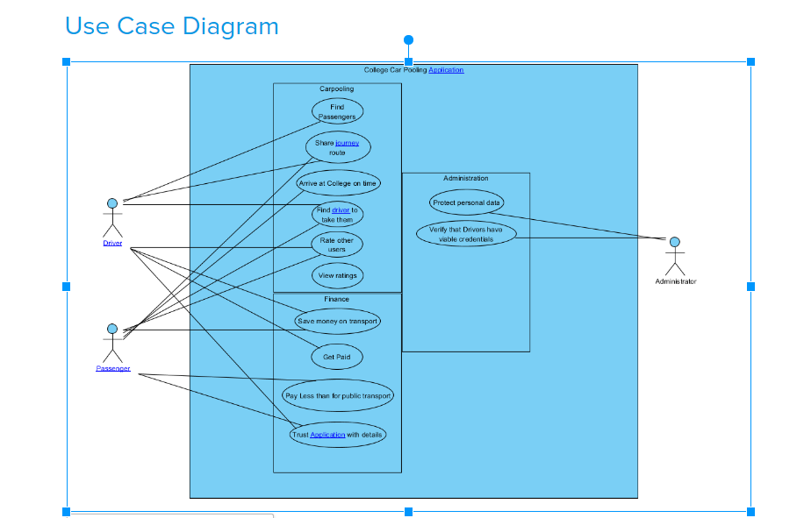

Slide 7
Project Retrospective - The Right
Time Management.
Organisation.
Team participation.
Team moral.
Mutual understanding.
Personal growth.

Slide 8
The Bad
Visual Paradigm is a buggy faulty software that deleted our precious work.
Keeping up to date with our journal entries.
We didn’t put in enough time to understand some of the requirements.
The story map was perplexing.

Slide 9
Differently
Not use Visual Paradigm.
Time schedule more efficiently.
We document more precisely as we did the work.

